Slide 1
Chapter 6 Functions

Slide 2
Opening Problem
Find the sum of integers from 1 to 10, from 20 to 37, and from 35 to 49, respectively.

Slide 3
Problem
sum = 0
for i in range(1, 11):
sum += i # equivalent to sum= sum+i
print("Sum from 1 to 10 is", sum)
sum = 0
for i in range(20, 38):
sum += i
print("Sum from 20 to 37 is", sum)
sum = 0
for i in range(35, 50):
sum += i
print("Sum from 35 to 49 is", sum)

Slide 4
Problem
sum = 0
for i in range(1, 11):
sum += i
print("Sum from 1 to 10 is", sum)
sum = 0
for i in range(20, 38):
sum += i
print("Sum from 20 to 37 is", sum)
sum = 0
for i in range(35, 50):
sum += i
print("Sum from 35 to 49 is", sum)

Slide 5
Solution
def sum(i1, i2):
result = 0
for i in range(i1, i2 + 1):
result += i
return result
def main():
print("Sum from 1 to 10 is", sum(1, 10))
print("Sum from 20 to 37 is", sum(20, 37))
print("Sum from 35 to 49 is", sum(35, 49))
main() # Call the main function

Slide 6
Objectives
To define functions (§6.2).
To invoke value-returning functions (§6.3).
To invoke functions that does not return a value (§6.4).
To pass arguments by values (§6.5).
To pass arguments by values (§6.6).
To develop reusable code that is modular, easy to read, easy to debug, and easy to maintain (§6.7).
To create modules for reusing functions (§§6.7-6.8).
To determine the scope of variables (§6.9).
To define functions with default arguments (§6.10).
To return multiple values from a function (§6.11).
To apply the concept of function abstraction in software development (§6.12).
To design and implement functions using stepwise refinement (§6.13).
To simplify drawing programs using functions (§6.14).

Slide 7
Defining Functions
A function is a collection of statements that are grouped together to perform an operation.

Slide 8
a = float(input(“Please enter an angle:))
sine_of_a = sine(a)
display_angle(a)

Slide 9
Function Header
A function contains a header and body. The header begins with the def keyword, followed by function’s name and parameters, followed by a colon.

Slide 10
Formal Parameters
The variables defined in the function header are known as formal parameters.

Slide 11
Actual Parameters
When a function is invoked, you pass a value to the parameter. This value is referred to as actual parameter or argument.

Slide 12
Return Value
A function may return a value using the return keyword.

Slide 13
Calling Functions
Testing the max function
This program demonstrates calling a function max to return the largest of the int values
TestMax

Slide 14
Calling Functions, cont.
animation

Slide 15
Trace Function Invocation
animation
Invoke the main function

Slide 16
Trace Function Invocation
animation
i is now 5

Slide 17
Trace Function Invocation
animation
j is now 2

Slide 18
Trace Function Invocation
animation
invoke max(i, j)

Slide 19
Trace Function Invocation
animation
invoke max(i, j)
Pass the value of i to num1
Pass the value of j to num2

Slide 20
Trace Function Invocation
animation
(num1 > num2) is true since num1 is 5 and num2 is 2

Slide 21
Trace Function Invocation
animation
result is now 5

Slide 22
Trace Function Invocation
animation
return result, which is 5

Slide 23
Trace Function Invocation
animation
return max(i, j) and assign the return value to k

Slide 24
Trace Function Invocation
animation
Execute the print statement

Slide 25
Trace Function Invocation
animation
Return to the caller

Slide 26
Call Stacks

Slide 27
Call Stacks

Slide 28
Functions With/Without Return Values
This type of function does not return a value. The function performs some actions.
PrintGradeFunction
ReturnGradeFunction

Slide 29
The None Value
A function that does not return a value is known as a void function in other programming languages such as Python, C++, and C#. In Python, such function returns a special value None.
def sum(number1, number2):
total = number1 + number2
print(sum(1, 2))

Slide 30
Passing Arguments by Positions
def nPrintln(message, n):
for i in range(0, n):
print(message)
Suppose you invoke the function using
nPrintln(“Welcome to Python”, 5)
What is the output?
Suppose you invoke the function using
nPrintln(“Computer Science”, 15)
What is the output?
What is wrong
nPrintln(4, “Computer Science”)

Slide 31
Keyword Arguments
def nPrintln(message=“No message”, n):
for i in range(0, n):
print(message)
What is wrong
nPrintln(4, “Computer Science”)
Is this OK?
nPrintln(n = 4, message = “ECE”)

Slide 32
Pass by Reference
In Python, all data are objects. A variable for an object is actually a reference to the object. When you invoke a function with a parameter, the reference for the object is passed to the function. This is referred to as pass-by-value. For simplicity, we say that the value of an argument is passed to a parameter when invoking a function. Precisely, the value is actually a reference value to the object.
If the argument is a number or a string, the argument is not affected, regardless of the changes made to the parameter inside the function.
If the argument is mutable, like a list or set, the actual object that is referenced by the argument will be modified inside function.
Increment

Slide 33
#Listing or LiveExample 6.4
def main():
x = 1
print("Before the call, x is", x)
increment(x)
print("After the call, x is", x)
def increment(x):
x += 1
print("\tn inside the function is", x)
main() # Call the main function

Slide 34
#Listing or LiveExample 6.4 Augmented
def main():
x = 1
print("Before the call, x is", x)
increment(x)
print("After the call, x is", x)
lst = [1,2,3]
print("lst in main:",lst)
print("modify_list() returns:",modify_list(lst))
print("After the call, lst is",lst)
def increment(x):
x += 1
print("\t x inside the function is", x)
def modify_list(lst):
lst.append(4)
print("\t lst inside modify_lst:",lst)
return
main() # Call the main function

Slide 35
Pass by Value

Slide 36
Modularizing Code
Functions can be used to reduce redundant coding and enable code reuse. Functions can also be used to modularize code and improve the quality of the program.
GCDFunction
TestGCDFunction
PrimeNumberFunction

Slide 37
Problem: Converting Decimals to Hexadecimals
Write a function that converts a decimal integer to a hexadecimal.
Dec2Hex

Slide 38
Scope of Variables
Scope: the part of the program where the variable can be referenced.
A variable created inside a function is referred to as a local variable. Local variables can only be accessed inside a function. The scope of a local variable starts from its creation and continues to the end of the function that contains the variable.
In Python, you can also use global variables. They are created outside all functions and are accessible to all functions in their scope.

Slide 39
Example 1
globalVar = 1
def f1():
localVar = 2
print(globalVar)
print(localVar)
f1()
print(globalVar)
print(localVar) # Out of scope. This gives an error

Slide 40
Example 2
x = 1
def f1():
x = 2
print(x) # Displays 2
f1()
print(x) # Displays 1

Slide 41
Example 3
x = eval(input("Enter a number: "))
if x > 0:
y = 4
print(y) # This gives an error if y is not created

Slide 42
Example 4
sum = 0
for i in range(5):
sum += i
print(i)

Slide 43
Example 5
x = 1
def increase():
global x
x = x + 1
print(x) # Displays 2
increase()
print(x) # Displays 2

Slide 44
def isEven(num):
global evenCount, oddCount
if (num % 2 == 0):
evenCount += 1
return True
else:
oddCount +=1
return False
evenCount, oddCount = 0,0
x = int(input("Please enter an integer, 0 to end:"))
while(x != 0):
if isEven(x):
print(x,"is even.")
else:
print(x,"is odd.")
print("Odd count:",oddCount,"Even count:",evenCount)
x = int(input("Please enter an integer, 0 to end:"))

Slide 45
even, odd = 0, 0
def isEven(num):
global even
global odd
if (num % 2 == 0):
even += 1
return True
else:
odd += 1
return False
x = input("Please enter an integer:")
if isEven(x):
print(x,"is even")
else: print(x, "is odd")

Slide 47
Default Arguments
Python allows you to define functions with default argument values. The default values are passed to the parameters when a function is invoked without the arguments.
DefaultArgumentDemo

Slide 48
Live Example 6.8 DefaultArgumentDemo.py
def printArea(width = 1, height = 2):
area = width * height
print("width:", width, "\theight:", height, "\tarea:", area)
printArea() # Default arguments width = 1 and height = 2
printArea(4, 2.5) # Positional arguments width = 4 and height = 2.5
printArea(height = 5, width = 3) # Keyword arguments width
printArea(width = 1.2) # Default height = 2
printArea(height = 6.2) # Default widht = 1

Slide 49
Returning Multiple Values
Python allows a function to return multiple values. Listing 6.9 defines a function that takes two numbers and returns them in non-descending order.
MultipleReturnValueDemo

Slide 50
Live Example 6.9: MultipleReturnValueDemo.py
def sort(number1, number2):
if number1 < number2:
return number1, number2
else:
return number2, number1
n1, n2 = sort(3, 2)
print("n1 is", n1)
print("n2 is", n2)

Slide 51
Generating Random Characters
RandomCharacter
TestRandomCharacter

Slide 52
# Listing 6.10 RandomCharacter.py
from random import randint # import randint
# Generate a random character between ch1 and ch2
def getRandomCharacter(ch1, ch2):
return chr(randint(ord(ch1), ord(ch2)))
# Generate a random lowercase letter
def getRandomLowerCaseLetter():
return getRandomCharacter('a', 'z')
# Generate a random uppercase letter
def getRandomUpperCaseLetter():
return getRandomCharacter('A', 'Z')
# Generate a random digit character
def getRandomDigitCharacter():
return getRandomCharacter('0', '9')
# Generate a random character
def getRandomASCIICharacter():
return getRandomCharacter(chr(0), chr(127))

Slide 53
LiveExample 6.11: TestRandomCharacter.py
import RandomCharacter
NUMBER_OF_CHARS = 175 # Number of characters to generate
CHARS_PER_LINE = 25 # Number of characters to display per line
# Print random characters between 'a' and 'z', 25 chars per line
for i in range(NUMBER_OF_CHARS):
print(RandomCharacter.getRandomLowerCaseLetter(), end = "")
if (i + 1) % CHARS_PER_LINE == 0:
print() # Jump to the new line

Slide 54
Function Abstraction
You can think of the function body as a black box that contains the detailed implementation for the function.

Slide 55
Benefits of Functions
Write a function once and reuse it anywhere.
Information hiding. Hide the implementation from the user.
Reduce complexity.

Slide 56
Stepwise Refinement
The concept of function abstraction can be applied to the process of developing programs. When writing a large program, you can use the “divide and conquer” strategy, also known as stepwise refinement, to decompose it into subproblems. The subproblems can be further decomposed into smaller, more manageable problems.

Slide 57
PrintCalender Case Study
Let us use the PrintCalendar example to demonstrate the stepwise refinement approach.
PrintCalender

Slide 58
Design Diagram

Slide 59
Design Diagram

Slide 60
Design Diagram

Slide 61
Design Diagram

Slide 62
Design Diagram

Slide 63
Design Diagram

Slide 64
Implementation: Top-Down
Top-down approach is to implement one function in the structure chart at a time from the top to the bottom. Stubs can be used for the functions waiting to be implemented. A stub is a simple but incomplete version of a function. The use of stubs enables you to test invoking the function from a caller. Implement the main function first and then use a stub for the printMonth function. For example, let printMonth display the year and the month in the stub. Thus, your program may begin like this:
A Skeleton for PrintCalendar

Slide 65
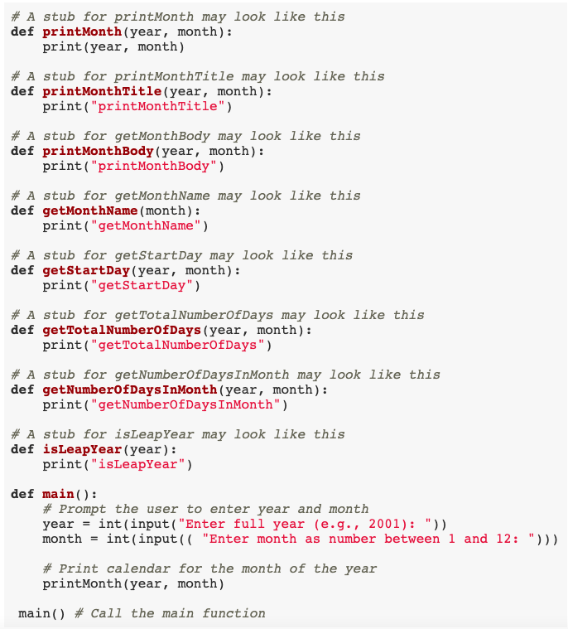

Slide 66
# LiveExample 6.13: Print the calendar for a month in a year
def printMonth(year, month):
# Print the headings of the calendar
printMonthTitle(year, month)
# Print the body of the calendar
printMonthBody(year, month)
# Print the month title, e.g., May, 1999
def printMonthTitle(year, month):
print(" ", getMonthName(month), " ", year)
print("-----------------------------")
print(" Sun Mon Tue Wed Thu Fri Sat")

Slide 67
# Print month body
def printMonthBody(year, month):
# Get start day of the week for the first date in the month
startDay = getStartDay(year, month)
# Get number of days in the month
numberOfDaysInMonth = getNumberOfDaysInMonth(year, month)
# Pad space before the first day of the month
i = 0
for i in range(startDay):
print(" ", end = "")
for i in range(1, numberOfDaysInMonth + 1):
print(format(i, '4d'), end = "")
if (i + startDay) % 7 == 0:
print() # Jump to the new line

Slide 68
# Get the English name for the month
def getMonthName(month):
if month == 1:
monthName = "January"
elif month == 2:
monthName = "February"
elif month == 3:
monthName = "March"
elif month == 4:
monthName = "April"
elif month == 5:
monthName = "May"
elif month == 6:
monthName = "June"
elif month == 7:
monthName = "July"
elif month == 8:
monthName = "August"
elif month == 9:
monthName = "September"
elif month == 10:
monthName = "October"
elif month == 11:
monthName = "November"
else:
monthName = "December"
return monthName

Slide 69
# Get the start day of month/1/year
def getStartDay(year, month):
START_DAY_FOR_JAN_1_1800 = 3
# Get total number of days from 1/1/1800 to month/1/year
totalNumberOfDays = getTotalNumberOfDays(year, month)
# Return the start day for month/1/year
return (totalNumberOfDays + START_DAY_FOR_JAN_1_1800) % 7

Slide 70
# Get the total number of days since January 1, 1800
def getTotalNumberOfDays(year, month):
total = 0
# Get the total days from 1800 to 1/1/year
for i in range(1800, year):
if isLeapYear(i):
total = total + 366
else:
total = total + 365
# Add days from Jan to the month prior to the calendar month
for i in range(1, month):
total = total + getNumberOfDaysInMonth(year, i)
return total

Slide 71
# Get the number of days in a month
def getNumberOfDaysInMonth(year, month):
if (month == 1 or month == 3 or month == 5 or month == 7 or
month == 8 or month == 10 or month == 12):
return 31
if month == 4 or month == 6 or month == 9 or month == 11:
return 30
if month == 2:
return 29 if isLeapYear(year) else 28
return 0 # If month is incorrect

Slide 72
# Determine if it is a leap year
def isLeapYear(year):
return year % 400 == 0 or (year % 4 == 0 and year % 100 != 0)
def main():
# Prompt the user to enter year and month
year = int(input("Enter full year (e.g., 2001): "))
month = int(input(("Enter month as number between 1 and 12: ")))
# Print calendar for the month of the year
printMonth(year, month)
main() # Call the main function

Slide 73
Implementation: Bottom-Up
Bottom-up approach is to implement one function in the structure chart at a time from the bottom to the top. For each function implemented, write a test program to test it. Both top-down and bottom-up functions are fine. Both approaches implement the functions incrementally and help to isolate programming errors and makes debugging easy. Sometimes, they can be used together.

Slide 74
Turtle: Developing Reusable Graphics Functions
def drawLine(x1, y1, x2, y2):
def writeString(s, x, y):
def drawPoint(x, y):
def drawCircle(x = 0, y = 0, radius = 10):
def drawRectangle(x = 0, y = 0, width = 10, height = 10):
UsefulTurtleFunctions
UseCustomTurtleFunctions

